Slide 1
Industrial Economics PPT - 10
Perfect Competition
Short Run Equilibrium, Shut Down Point,
Long Run Equilibrium

Slide 2
Firms in Competitive Markets
A market is competitive if each buyer and seller is small compared to the size of the market and, therefore, has little ability to influence market prices.
By contrast, if a firm can influence the market price of the good it sells, it is said to have market power.
What Is a Competitive Market?
Competitive Market: a market with many buyers and sellers trading identical products so that each buyer and seller is a price taker.

Slide 3
The Meaning of Competition
A competitive market, sometimes called a perfectly competitive market, has three main characteristics:
• There are many buyers and many sellers in the market.
• The goods offered by the various sellers are largely the same.
• Firms can freely enter or exit the market.
As a result of these conditions, the actions of any single buyer or seller in the market have a negligible impact on the market price. Each buyer and seller takes the market price as given.

Slide 4
As an example, consider the market for milk.
No single consumer of milk can influence the price of milk because each buys a small amount relative to the size of the market.
Similarly, each dairy farmer has limited control over the price because many other sellers are offering milk that is essentially identical. Because each seller can sell all he wants at the going price, he has little reason to charge less, and if he charges more, buyers will go elsewhere.
Buyers and sellers in competitive markets must accept the price the market determines and, therefore, are said to be price takers.
In case of free entry & exit of firms, for instance, anyone can decide to start a dairy farm, and if any existing dairy farmer can decide to leave the dairy business, then the dairy industry satisfies this condition.

Slide 5
The Revenue of a Competitive Firm
A firm in a competitive market, like most other firms in the economy, tries to maximize profit (total revenue minus total cost).
Let’s consider a specific firm: the Vaca Family Dairy Farm.
The Vaca Farm produces a quantity of milk, Q, and sells each unit at the market price, P. The farm’s total revenue is P × Q.
For example, if a gallon of milk sells for $6 and the farm sells 1,000 gallons, its total revenue is $6,000.
Table 1 shows the revenue for the Vaca Family Dairy Farm. The first two columns show the amount of output the farm produces and the price at which it sells its output. The third column is the farm’s total revenue. The table assumes that the price of milk is $6 a gallon, so total revenue is $6 times the number of gallons.

Slide 6
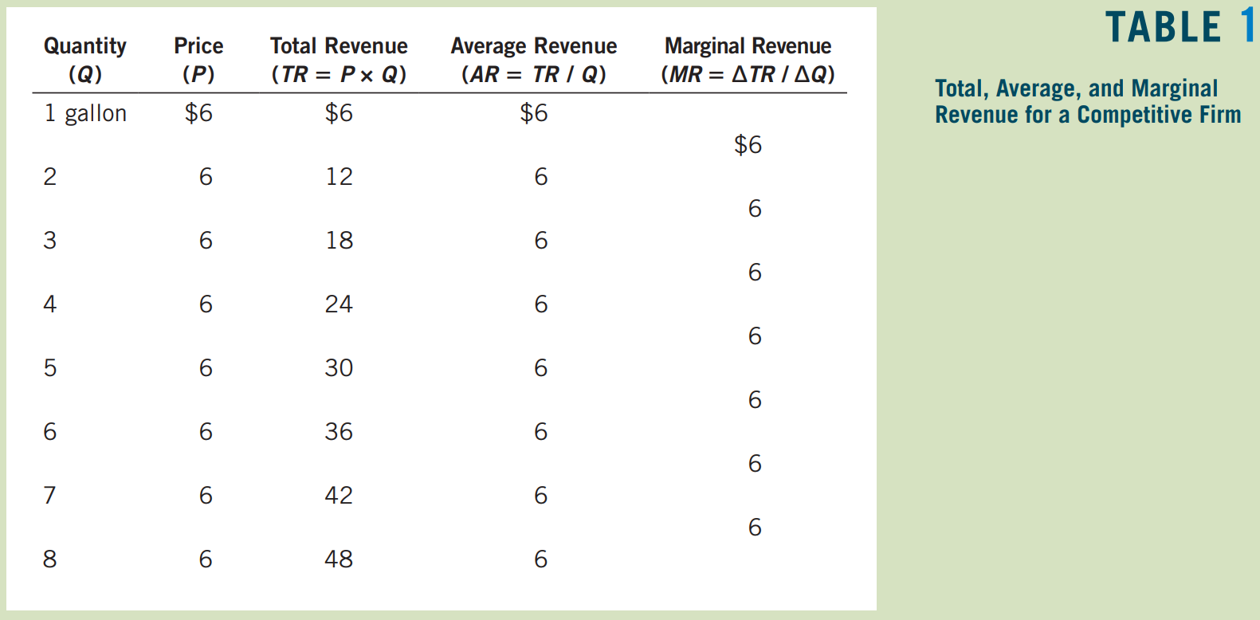

Slide 7
The fourth column in the table shows average revenue, which is total revenue (from the third column) divided by the amount of output (from the first column).
Average revenue tells us how much revenue a firm receives for the typical unit sold. Average revenue is total revenue (P × Q) divided by the quantity (Q). Therefore, for all types of firms, average revenue equals the price of the good. AR = TR/Q
The fifth column shows marginal revenue, which is the change in total revenue from the sale of each additional unit of output. In Table 1, marginal revenue equals $6, the price of a gallon of milk.
This result illustrates a lesson that applies only to competitive firms. Total revenue is P × Q, and P is fixed for a competitive firm. Therefore, when Q rises by 1 unit, total revenue rises by P dollars.
For competitive firms, marginal revenue equals the price of the good.
Notes:
Average Revenue: total revenue divided by the quantity sold
Marginal Revenue: the change in total revenue from an additional unit sold

Slide 8
Profit Maximization and the Competitive Firm’s Supply Curve
The goal of a firm is to maximize profit, which equals total revenue minus total cost.
How a competitive firm maximizes its profit and how that decision determines its supply curve?
A Simple Example of Profit Maximization
Let’s begin our analysis of the firm’s supply decision with the example in Table 2. In the first column of the table is the number of gallons of milk the Vaca Family Dairy Farm produces. The second column shows the farm’s total revenue, which is $6 times the number of gallons. The third column shows the farm’s total cost. Total cost includes fixed costs, which are $3 in this example, and variable costs, which depend on the quantity produced. The fourth column shows the farm’s profit, which is computed by subtracting total cost from total revenue.
Because the Vaca family’s goal is to maximize profit, it chooses to produce the quantity of milk that makes profit as large as possible. In this example, profit is maximized when the farm produces either 4 or 5 gallons of milk, for a profit of $7.

Slide 9
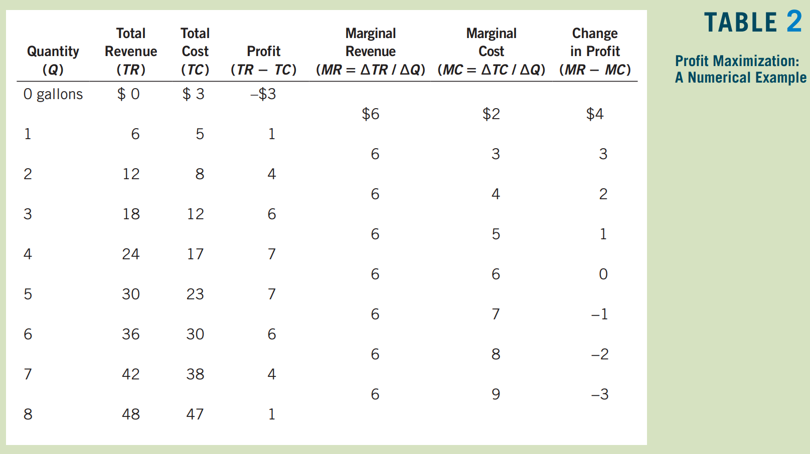

Slide 10
The Vacas can find the profit-maximizing quantity by comparing the marginal revenue and marginal cost from each unit produced. The fifth and sixth columns in Table 2 compute marginal revenue and marginal cost from the changes in total revenue and total cost, and the last column shows the change in profit for each additional gallon produced.
As long as marginal revenue exceeds marginal cost, increasing the quantity produced raises profit. As a result, the Vacas would not produce beyond 5 gallons.
One of the Ten Principles of Economics is that rational people think at the margin. How the Vaca Family Dairy Farm can apply this principle?
If marginal revenue is greater than marginal cost—as it is at 1, 2, or 3 gallons—the Vacas should increase the production of milk because it will put more money in their pockets (marginal revenue) than it takes out (marginal cost).
If marginal revenue is less than marginal cost—as it is at 6, 7, or 8 gallons—the Vacas should decrease production.
If the Vacas think at the margin and make incremental adjustments to the level of production, they end up producing the profit-maximizing quantity.

Slide 11
The Marginal-Cost Curve and the Firm’s Supply Decision
To extend this analysis of profit maximization, consider the cost curves in Figure 1.
These cost curves have the three features: The marginal-cost curve (MC) is upward sloping. The average-total-cost curve (ATC) is U-shaped. And the marginal cost curve crosses the average-total-cost curve at the minimum of average total cost.
The figure also shows a horizontal line at the market price (P). The price line is horizontal because a competitive firm is a price taker: The price of the firm’s output is the same regardless of the quantity that the firm decides to produce.
For a competitive firm, the firm’s price equals both its average revenue (AR) and its marginal revenue (MR).

Slide 12
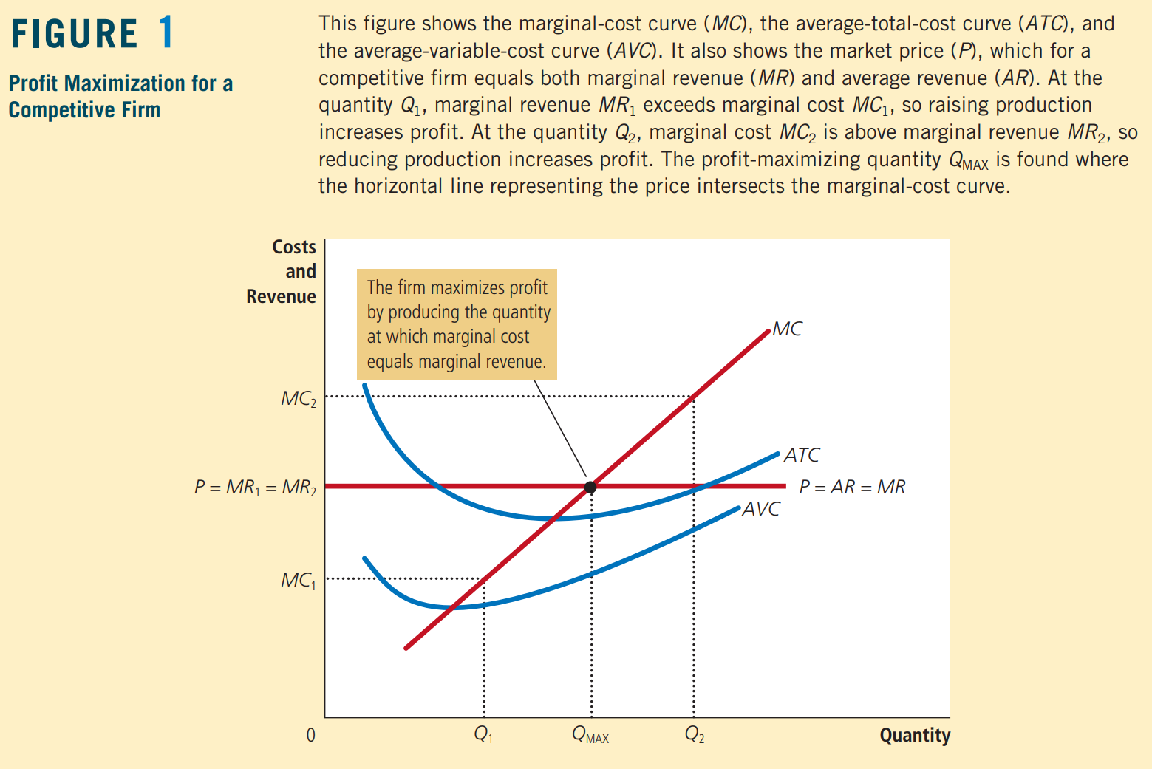

Slide 13
Regardless of whether the firm begins with production at a low level (such as Q₁) or at a high level (such as Q₂), the firm will eventually adjust production until the quantity produced reaches Q_{MAX}.
This analysis yields three general rules for profit maximization:
If Marginal Revenue is greater than Marginal Cost (MR>MC), the firm should increase its output.
If Marginal Cost is greater than Marginal Revenue (MC>MR), the firm should decrease its output.
At the profit-maximizing level of output, Marginal Revenue and Marginal Cost are exactly equal (MC=MR).
These rules are the key to rational decision making by any profit-maximizing firm.

Slide 14
Firm’s Supply Decision
Let us now see how the competitive firm decides what quantity of its good to supply to the market.
Because a competitive firm is a price taker, its marginal revenue equals the market price (MR=P).
For any given price, the competitive firm’s profit-maximizing quantity of output is found by looking at the intersection of the price with the marginal-cost curve (Q_{MAX}).
Suppose that the price prevailing in this market rises, perhaps because of an increase in market demand.
Figure 2 shows how a competitive firm responds to the price increase.

Slide 15
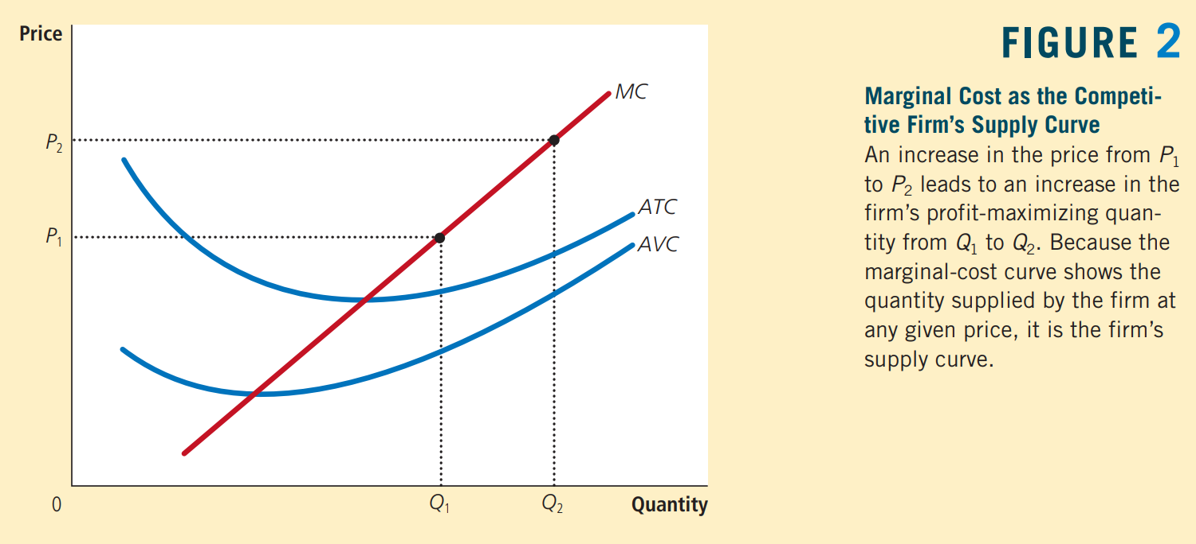

Slide 16
When the price is P₁, the firm produces quantity Q₁, the quantity that equates marginal cost to the price.
When the price rises to P₂, the firm finds that marginal revenue is now higher than marginal cost (MR>MC) at the previous level of output, so the firm increases production.
The new profit-maximizing quantity is Q₂, at which marginal cost equals the new, higher price.
In essence, because the firm’s marginal-cost curve determines the quantity of the good the firm is willing to supply at any price, the marginal-cost curve is also the competitive firm’s supply curve.

Slide 17
The Firm’s Short-Run Decision to Shut Down
In certain circumstances, the firm will decide to shut down and not produce anything at all. We need to distinguish between a temporary shutdown of a firm and the permanent exit of a firm from the market.
A shutdown refers to a short-run decision not to produce anything during a specific period of time because of current market conditions.
Exit refers to a long-run decision to leave the market.
The short-run and long-run decisions differ because most firms cannot avoid their fixed costs in the short run but can do so in the long run. That is, a firm that shuts down temporarily still has to pay its fixed costs, whereas a firm that exits the market does not have to pay any costs at all, fixed or variable.
For example, consider the production decision that a farmer faces. The cost of the land is one of the farmer’s fixed costs. If the farmer decides not to produce any crops one season, the land lies fallow, and he cannot recover this cost. When making the short-run decision of whether to shut down for a season, the fixed cost of land is said to be a sunk cost. By contrast, if the farmer decides to leave farming altogether, he can sell the land. When making the long-run decision of whether to exit the market, the cost of land is not sunk.

Slide 18
What determines a firm’s shutdown decision?
If the firm shuts down, it loses all revenue from the sale of its product. At the same time, it saves the variable costs of making its product (but must still pay the fixed costs). Thus, the firm shuts down if the revenue that it would earn from producing is less than its variable costs of production.
Shutdown Rule: If TR stands for total revenue and VC stands for variable cost, then the firm’s decision can be written as:
Shut down if TR < VC.
The firm shuts down if total revenue is less than variable cost.
By dividing both sides of this inequality by the quantity Q, we can write it as:
Shut down if TR/Q < VC/Q.
The left side of the inequality, TR/Q, is total revenue (P × Q) divided by quantity Q, which is average revenue, most simply expressed as the good’s price, P. The right side of the inequality, VC/Q, is average variable cost, AVC. Therefore, the firm’s shutdown rule can be restated as:
Shut down if P < AVC.
That is, a firm chooses to shut down if the price of the good is less than the average variable cost of production.
Notes:
This criterion is intuitive: When choosing to produce, the firm compares the price it receives for the typical unit to the average variable cost that it must incur to produce the typical unit. If the price doesn’t cover the average variable cost, the firm is better off stopping production altogether. The firm still loses money (because it has to pay fixed costs), but it would lose even more money by staying open. The firm can reopen in the future if conditions change so that price exceeds average variable cost.

Slide 19
A full description of a competitive firm’s profit-maximizing strategy:
If the firm produces anything, it produces the quantity at which marginal cost equals the good’s price, which the firm takes as given.
Yet if the price is less than average variable cost at that quantity, the firm is better off shutting down temporarily and not producing anything.
The competitive firm’s short-run supply curve is the portion of its marginal-cost curve that lies above average variable cost.
These results are illustrated in Figure 3.

Slide 20
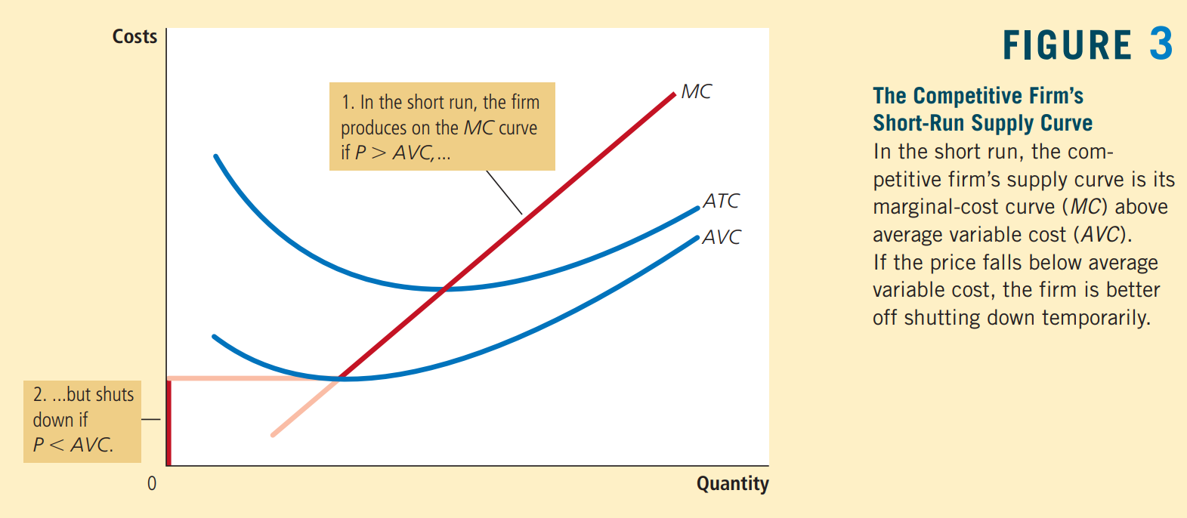

Slide 21
Sunk Costs
Economists say that a cost is a sunk cost when it has already been committed and cannot be recovered. Because nothing can be done about sunk costs, you should ignore them when making decisions about various aspects of life, including business strategy.
Our analysis of the firm’s shutdown decision is one example of the irrelevance of sunk costs.
We assume that the firm cannot recover its fixed costs by temporarily stopping production. That is, regardless of the quantity of output supplied (even if it is zero), the firm still has to pay its fixed costs. As a result, the fixed costs are sunk in the short run, and the firm should ignore them when deciding how much to produce.
The firm’s short-run supply curve is the part of the marginal-cost curve that lies above average variable cost, and the size of the fixed cost does not matter for this supply decision.

Slide 22

Case Study: Near-Empty Restaurants
Have you ever walked into a restaurant for lunch and found it almost empty? Why, you might have asked, does the restaurant even bother to stay open? It might seem that the revenue from so few customers could not possibly cover the cost of running the restaurant.
In making the decision of whether to open for lunch, a restaurant owner must keep in mind the distinction between fixed and variable costs. Many of a restaurant’s costs—the rent, kitchen equipment, tables, plates, silverware, and so on— are fixed. Shutting down during lunch would not reduce these costs. In other words, these costs are sunk in the short run. When the owner is deciding whether to serve lunch, only the variable costs—the price of the additional food and the wages of the extra staff—are relevant.
The owner shuts down the restaurant at lunchtime only if the revenue from the few lunchtime customers fails to cover the restaurant’s variable costs.

Slide 23
The Firm’s Long-Run Decision to Exit or Enter a Market
A firm’s long-run decision to exit a market is similar to its shutdown decision. If the firm exits, it will again lose all revenue from the sale of its product, but now it will save not only its variable costs of production but also its fixed costs. Thus, the firm exits the market if the revenue it would get from producing is less than its total costs.
Exit Rule: Writing it mathematically, if TR stands for total revenue, and TC stands for total cost, then the firm’s exit rule can be written as:
Exit if TR < TC.
The firm exits if total revenue is less than total cost.
By dividing both sides of this inequality by quantity Q, we can write it as:
Exit if TR/Q < TC/Q.
We can simplify this further by noting that TR/Q is average revenue, which equals the price P, and that TC/Q is average total cost, ATC. Therefore, the firm’s exit rule is:
Exit if P < ATC.
That is, a firm chooses to exit if the price of its good is less than the average total cost of production.

Slide 24
A parallel analysis applies to an entrepreneur who is considering starting a firm. He will enter the market if starting a firm would be profitable, which occurs if the price of the good exceeds the average total cost of production. The entry rule is:
Enter if P > ATC.
The rule for entry is exactly the opposite of the rule for exit.
A competitive firm’s long-run profit-maximizing strategy:
If the firm produces anything, it chooses the quantity at which marginal cost equals the price of the good.
Yet if the price is less than the average total cost at that quantity, the firm chooses to exit (or not enter) the market.
The competitive firm’s long-run supply curve is the portion of its marginal-cost curve that lies above average total cost.
These results are illustrated in Figure 4.

Slide 25
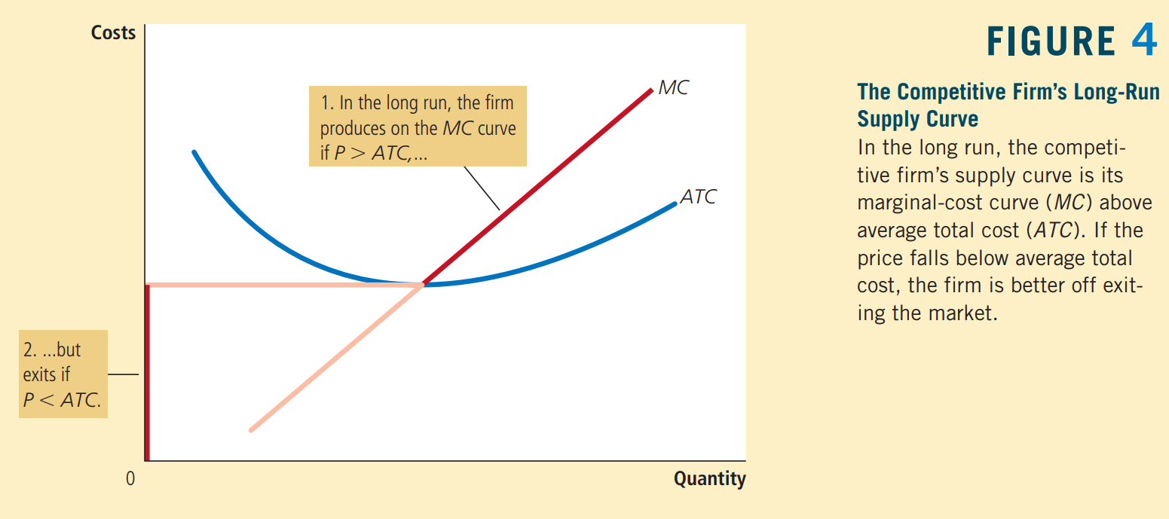

Slide 26
Measuring Profit in Our Graph for the Competitive Firm
Profit equals total revenue (TR) minus total cost (TC):
Profit = TR - TC.
We can rewrite this definition by multiplying and dividing the right side by Q:
Profit = (TR/Q - TC/Q) * Q.
But note that TR/Q is average revenue, which is the price, P, and TC/Q is average total cost, ATC. Therefore,
Profit = (P - ATC) * Q.
This way of expressing the firm’s profit allows us to measure profit in our graphs.
Panel (a) of Figure 5 shows a firm earning positive profit. The firm maximizes profit by producing the quantity at which price equals marginal cost. Now look at the shaded rectangle. The height of the rectangle is P − ATC, the difference between price and average total cost. The width of the rectangle is Q, the quantity produced. Therefore, the area of the rectangle is (P − ATC) × Q, which is the firm’s profit.
Similarly, panel (b) of Figure 5 shows a firm with losses (negative profit). In this case, maximizing profit means minimizing losses, a task accomplished once again by producing the quantity at which price equals marginal cost. Now consider the shaded rectangle. The height of the rectangle is ATC − P, and the width is Q. The area is (ATC − P) × Q, which is the firm’s loss. Because a firm in this situation is not making enough revenue on each unit to cover its average total cost, it would choose to exit the market in the long run.

Slide 27
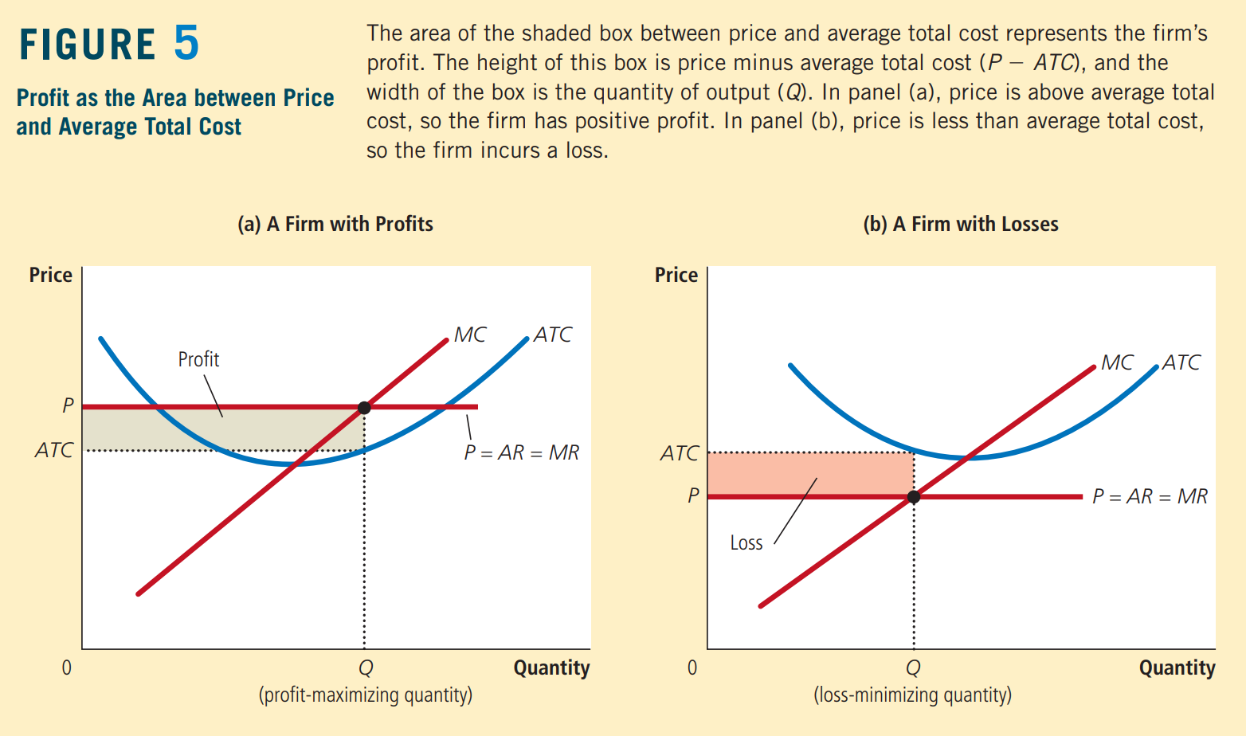

Slide 28
The Supply Curve in a Competitive Market
Now that we have examined the supply decision of a single firm, we can discuss the supply curve for a market. There are two cases to consider.
First, we examine a market with a fixed number of firms.
Second, we examine a market in which the number of firms can change as old firms exit the market and new firms enter.
Both cases are important, for each applies to a specific time horizon.
Over short periods of time, it is often difficult for firms to enter and exit, so the assumption of a fixed number of firms is appropriate. But over long periods of time, the number of firms can adjust to changing market conditions.

Slide 29
The Short Run: Market Supply with a Fixed Number of Firms
Consider first a market with 1,000 identical firms.
For any given price, each firm supplies a quantity of output so that its marginal cost equals the price, as shown in panel (a) of Figure 6. That is, as long as price is above average variable cost, each firm’s marginal-cost curve is its supply curve.
The quantity of output supplied to the market equals the sum of the quantities supplied by each of the 1,000 individual firms. Thus, to derive the market supply curve, we add the quantity supplied by each firm in the market.
As panel (b) of Figure 6 shows, because the firms are identical, the quantity supplied to the market is 1,000 times the quantity supplied by each firm.

Slide 30
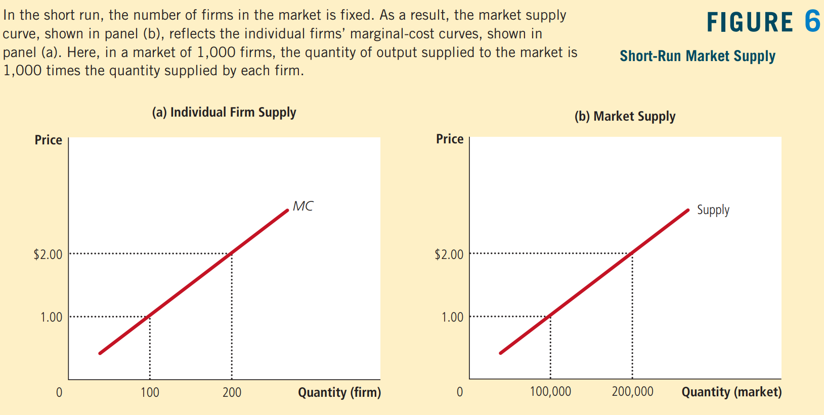

Slide 31
The Long Run: Market Supply with Entry and Exit
What happens if firms are able to enter or exit the market freely in the long run?
Let’s suppose that everyone has access to the same technology for producing the good and access to the same markets to buy the inputs for production. Therefore, all current and potential firms have the same cost curves.
Decisions about entry and exit in a market of this type depend on the incentives facing the owners of existing firms and the entrepreneurs who could start new firms.
If firms already in the market are profitable, then new firms will have an incentive to enter the market. This entry will expand the number of firms, increase the quantity of the good supplied, and drive down prices and profits.
Conversely, if firms in the market are making losses, then some existing firms will exit the market. Their exit will reduce the number of firms, decrease the quantity of the good supplied, and drive up prices and profits.
At the end of this process of entry and exit, firms that remain in the market must be making zero economic profit.

Slide 32
Recall that we can write a firm’s profit as:
Profit = (P - ATC) * Q.
This equation shows that an operating firm has zero profit if and only if the price of the good equals the average total cost of producing that good.
If price is above average total cost, profit is positive, which encourages new firms to enter.
If price is less than average total cost, profit is negative, which encourages some firms to exit.
The process of entry and exit ends only when price and average total cost are driven to equality.

Slide 33
Implication:
Competitive firms maximize profits by choosing a quantity at which price equals marginal cost.
Also, free entry and exit force price to equal average total cost.
But if price is to equal both marginal cost and average total cost, these two measures of cost must equal each other.
Marginal cost and average total cost are equal, however, only when the firm is operating at the minimum of average total cost.
The level of production with lowest average total cost is called the firm’s efficient scale. Therefore, in the long-run equilibrium of a competitive market with free entry and exit, firms must be operating at their efficient scale.
Panel (a) of Figure 7 shows a firm in such a long-run equilibrium.
In this figure, price P equals marginal cost MC, so the firm is maximizing profit. Price also equals average total cost ATC, so profit is zero. New firms have no incentive to enter the market, and existing firms have no incentive to leave the market.

Slide 34
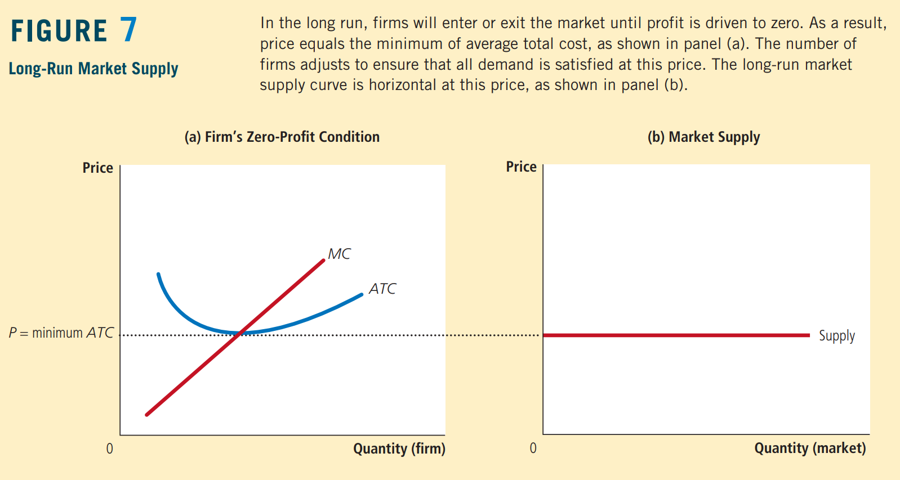

Slide 35
The long-run supply curve for the market
In a market with free entry and exit, there is only one price consistent with zero profit—the minimum of average total cost.
As a result, the long-run market supply curve must be horizontal at this price, as illustrated by the perfectly elastic supply curve in panel (b) of Figure 7.
Any price above this level would generate profit, leading to entry and an increase in the total quantity supplied.
Any price below this level would generate losses, leading to exit and a decrease in the total quantity supplied.
Eventually, the number of firms in the market adjusts so that price equals the minimum of average total cost, and there are enough firms to satisfy all the demand at this price.

Slide 36
Why Do Competitive Firms Stay in Business If They Make Zero Profit?
At first, it might seem odd that competitive firms earn zero profit in the long run. After all, people start businesses to make a profit. If entry eventually drives profit to zero, there might seem to be little reason to stay in business.
To understand the zero-profit condition more fully, recall that profit equals total revenue minus total cost and that total cost includes all the opportunity costs of the firm. In particular, total cost includes the time and money that the firm owners devote to the business. In the zero-profit equilibrium, the firm’s revenue must compensate the owners for these opportunity costs.
Consider an example. Suppose that, to start his farm, a farmer had to invest $1 million, which otherwise he could have deposited in a bank and earned $50,000 a year in interest. In addition, he had to give up another job that would have paid him $30,000 a year. Then the farmer’s opportunity cost of farming includes both the interest he could have earned and the forgone wages—a total of $80,000. Even if his profit is driven to zero, his revenue from farming compensates him for these opportunity costs.
Keep in mind that accountants and economists measure costs differently.
Accountants keep track of explicit costs but not implicit costs. That is, they measure costs that require an outflow of money from the firm, but they do not include the opportunity costs of production that do not involve an outflow of money.
As a result, in the zero-profit equilibrium, economic profit is zero, but accounting profit is positive. Our farmer’s accountant, for instance, would conclude that the farmer earned an accounting profit of $80,000, which is enough to keep the farmer in business.

Slide 37
A Shift in Demand in the Short Run and Long Run
Since now we know how firms make supply decisions, we can better explain how markets respond to changes in demand. Because firms can enter and exit in the long run but not in the short run, the response of a market to a change in demand depends on the time horizon. To see this, let’s trace the effects of a shift in demand over time.
Suppose the market for milk begins in a long-run equilibrium. Firms are earning zero profit, so price equals the minimum of average total cost. Panel (a) of Figure 8 shows this situation. The long-run equilibrium is point A, the quantity sold in the market is Q₁, and the price is P₁.
Now suppose scientists discover that milk has miraculous health benefits. As a result, the quantity of milk demanded at every price increases, and the demand curve for milk shifts outward from D₁ to D₂, as in panel (b) of Figure 8.
The short-run equilibrium moves from point A to point B; as a result, the quantity rises from Q₁ to Q₂, and the price rises from P₁ to P₂. All of the existing firms respond to the higher price by raising the amount they produce. Because each firm’s supply curve reflects its marginal-cost curve, how much each firm increases production is determined by the marginal-cost curve. In the new short-run equilibrium, the price of milk exceeds average total cost, so the firms are making positive profit.

Slide 38
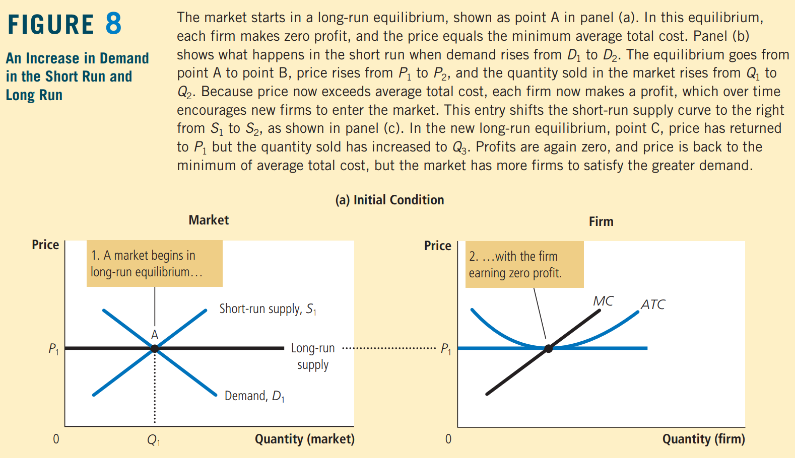

Slide 39
Over time, the profit generated in this market encourages new firms to enter. Some farmers may switch to producing milk instead of other farm products, for example.
As the number of firms grows, the quantity supplied at every price increases, the short-run supply curve shifts to the right from S₁ to S₂, as in panel (c) of Figure 8, and this shift causes the price of milk to fall.
Eventually, the price is driven back down to the minimum of average total cost, profits are zero, and firms stop entering. Thus, the market reaches a new long-run equilibrium, point C.
The price of milk has returned to P₁, but the quantity produced has risen to Q₃.
Each firm is again producing at its efficient scale, but because more firms are in the dairy business, the quantity of milk produced and sold is higher.

Slide 40
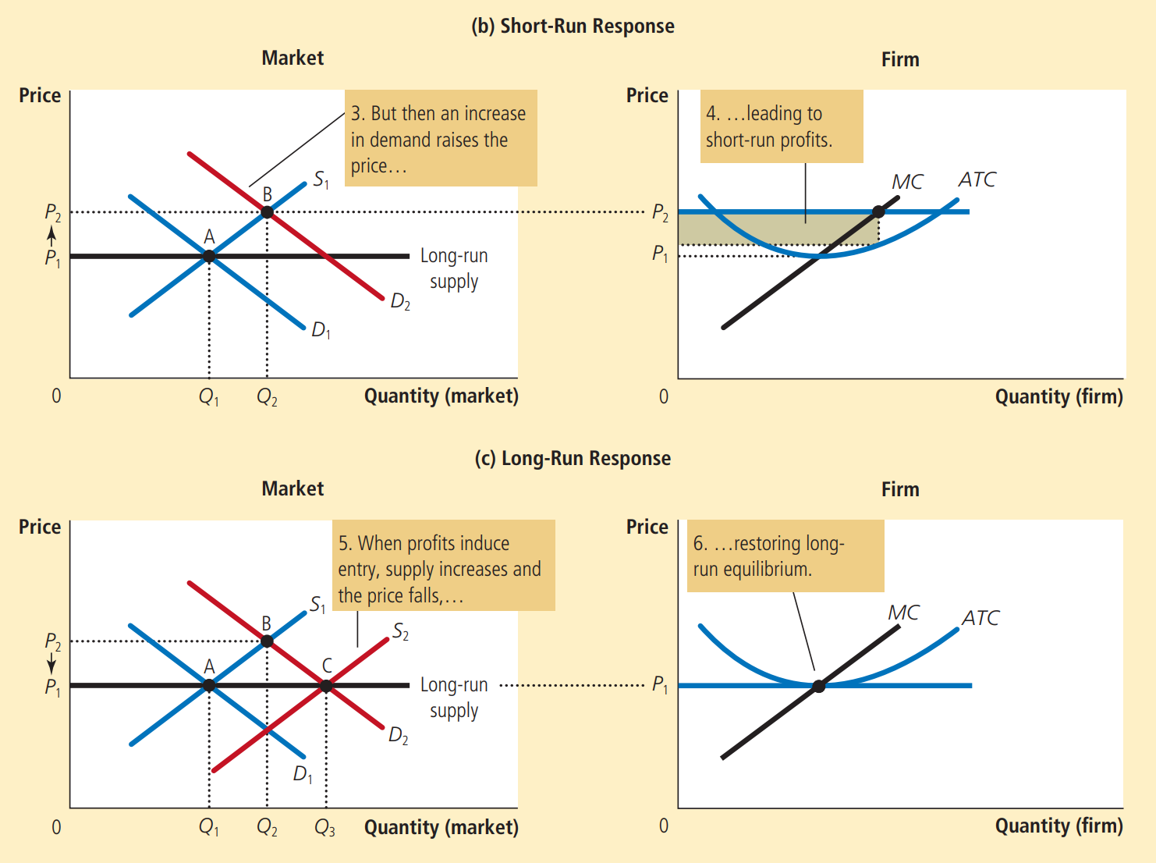

Slide 41
Why the Long-Run Supply Curve Might Slope Upward?
When the demand for the good increases, the long-run result is an increase in the number of firms and in the total quantity supplied, without any change in the price.
There are, however, two reasons that the long-run market supply curve might slope upward.
The first is that some resources used in production may be available only in limited quantities.
For example, consider the market for farm products.
Anyone can choose to buy land and start a farm, but the quantity of land is limited. As more people become farmers, the price of farmland is bid up, which raises the costs of all farmers in the market. Thus, an increase in demand for farm products cannot induce an increase in quantity supplied without also inducing a rise in farmers’ costs, which in turn means a rise in price. The result is a long-run market supply curve that is upward sloping, even with free entry into farming.
A second reason for an upward-sloping supply curve is that firms may have different costs.
For example, consider the market for painters. Anyone can enter the market for painting services, but not everyone has the same costs. Costs vary in part because some people work faster than others and in part because some people have better alternative uses of their time than others. For any given price, those with lower costs are more likely to enter than those with higher costs. To increase the quantity of painting services supplied, additional entrants must be encouraged to enter the market. Because these new entrants have higher costs, the price must rise to make entry profitable for them. Thus, the long-run market supply curve for painting services slopes upward even with free entry into the market.

Slide 42
Notice that if firms have different costs, some firms earn profit even in the long run. In this case, the price in the market reflects the average total cost of the marginal firm—the firm that would exit the market if the price were any lower. This firm earns zero profit, but firms with lower costs earn positive profit.
Entry does not eliminate this profit because would-be entrants have higher costs than firms already in the market. Higher-cost firms will enter only if the price rises, making the market profitable for them.
Thus, for these two reasons, a higher price may be necessary to induce a larger quantity supplied, in which case the long-run supply curve is upward sloping rather than horizontal.
Nonetheless, the basic lesson about entry and exit remains true. Because firms can enter and exit more easily in the long run than in the short run, the long-run supply curve is typically more elastic than the short-run supply curve.

Slide 43
Conclusion:
We have been discussing the behaviour of profit-maximizing firms that supply goods in perfectly competitive markets.
You may recall that one of the Ten Principles of Economics is that rational people think at the margin.
We have applied this idea to the competitive firm. Marginal analysis has given us a theory of the supply curve in a competitive market and, as a result, a deeper understanding of market outcomes.
We have learned that when you buy a good from a firm in a competitive market, you can be assured that the price you pay is close to the cost of producing that good.
In particular, if firms are competitive and profit maximizing, the price of a good equals the marginal cost of making that good.
In addition, if firms can freely enter and exit the market, the price also equals the lowest possible average total cost of production.

